Slide 1
Explorative Analysis of Fordgobike Dataset to Understand Consumer Needs to Better Serve them
By
Akoanung Ayaba Abendong

Slide 2
Investigation Overview
The goal of exploring the gobike dataset is to discover consumer prefences based on insightful deduction through producing visualizations. Aspect which are assessed in the dataset includes:
How distributed are the user type within the dataset?
How are rides distributed amongst the days of the week?
How the user type vary across the days of the week?

Slide 3
Dataset Overview
The dataset chosen for my project is the Fordgobike dataset. I choosed this dataset particular because it gives me the possibility to practice wrangling more before demonstrating insight from the data through visualizations.
The original dataset has 174952 fordgobike rides with 16 columns of diffrent atributes.
The original dataset has been modified nonetheless and now has 174952 forgobike rides with 22 columns
Some wrangling steps executed on the dataset includes; removing null values, changing datatype of start_time from object to datetime as well as tidying up the dataset by generating new columns which are helping in generating better inights from the data.
The different attributes which includes;
'bike_id', 'user_type', 'member_birth_year', 'member_gender', 'member_age', 'start_station_id', 'start_time','start_date', 'start_hour_of_day','start_day_of_week', 'start_month', 'start_station_name', 'start_station_latitude', 'start_station_longitude', 'end_time', 'duration_sec', 'duration_in_minute', 'end_station_id', 'end_station_name', 'end_station_latitude', 'end_station_longitude', 'bike_share_for_all_trip'.

Slide 4
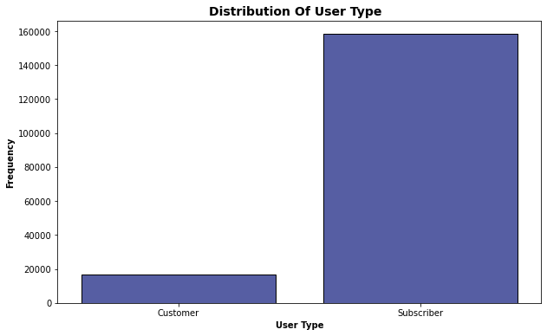
Distribution of Ride Users within the Dataset
Constructing a plot of the user-type against their respective counts in the data set helps answer the question of the distribution of the riders within the data.
Plot reveal almost all the riders are subscribers (~160000) with only less than 20000 being customers.
Finding why most fordgobike users are subscribers could be something more to explore but the data is not enough to produce such insight

Slide 5
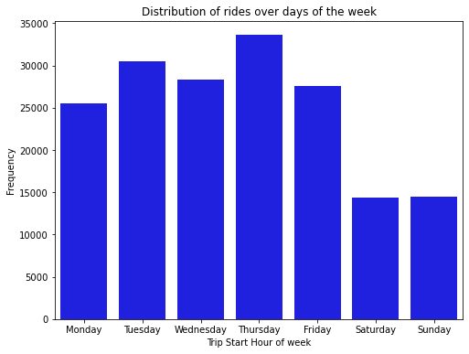
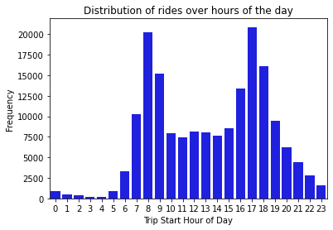
Distribution of rides amongst the days of the week and revealing the peak ride time of the day
The counts of the rides across the different days of the week provides useful insight to the distribution among the week day.
Similarly, from the ride distribution over hours of the day we can easily pick-out the peak ride times
From the visualizations, one can say the were more trips on weekdays(Monday - friday) than at the weekend (saturday and Saturday)
The peak times of rides were between 8am and 5pm with 8am and 5pm being the busiest hours of rides.

Slide 6
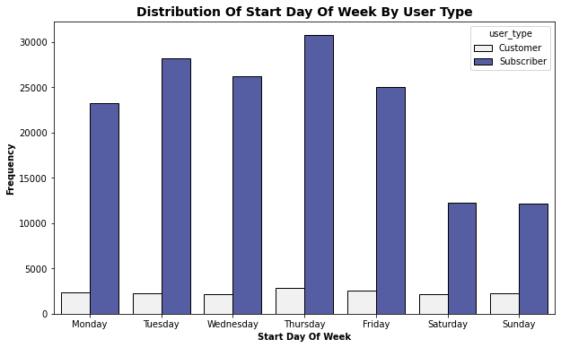
Variation of the Bike users across the days of the week
A display of the user types across the days of the week will be insightful
Plot demonstrates that there are more users who are subscribers than just ordinary customers and the bar charts reveal they ride more on week days than on weekends. Unlike users who are just ordinary customers that do not have a clear pattern of when they preferably ride.
One can not say for sure what cause this patterns but i guess the reason why there are more subscribed customers is probably because the subscription deals are perhaps better that ordinary customer deals.

Slide 7
Conclusion
Conclusively, the dataset provided had little modification to be done to it in terms of cleaning. Nonetheless, the dataset was tidy-up by adding some new columns which were helpful to generate better insights from the data.
The age of customers were also determine to have an idea about the riders and their age difference and it was noticed that very high age riders were in the dataset which did not seem to be a reality thus the columns for age was limited only to those whose ages were below 70years which is a more realistic age for riders.
From the visualizations made from the dataset, there is little difference in usage habits between male and female riders. However, it would be intriguing to examine any potential differences if there were more data available for female riders.
The study only analysed data from February, and it would be enlightening to see if there are any seasonal patterns in usage by looking at data from other months, specifically, whether usage increases during the summer or winter months.

